Slide 1
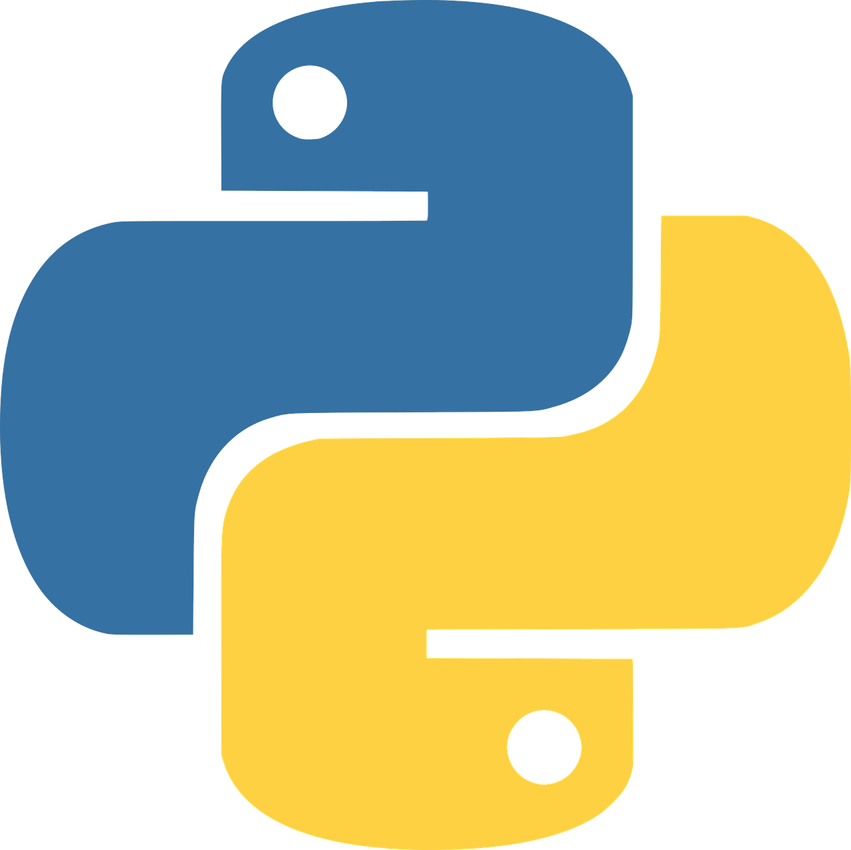
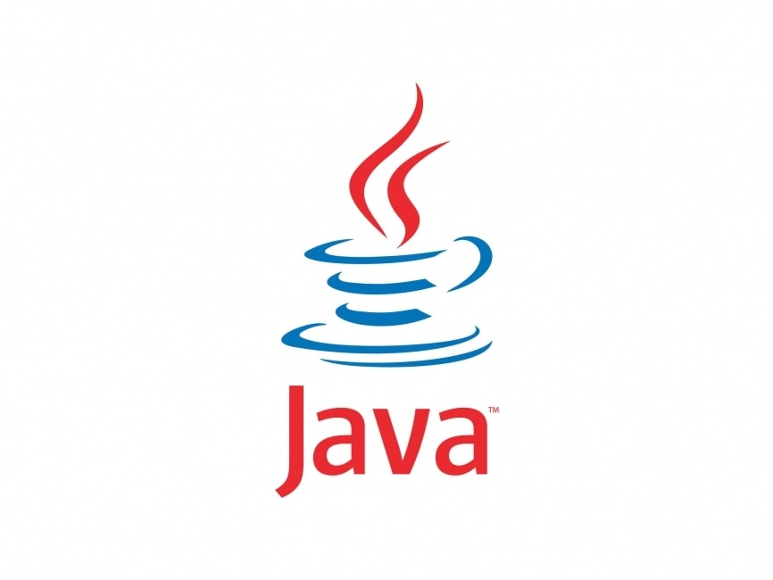
How to
Compile
And Run
Different
Languages on
Ubuntu
-Parsa Bordbar

Slide 2
$ sudo apt update
apt-get does not install new versions of software, instead it
Updates the package list for upgrades for packages that need upgrading, as well as new packages that have just come to the repositories. It will do this for all of repos and PPAs. From
http://linux.die.net/man/8/apt-get:
$ sudo apt upgrade
apt-get upgrade will fetch new versions of packages from apt-get update list and install all packages and their dependencies.
In this tutorial We are going to Use apt install command To install packages That we need..

Slide 3
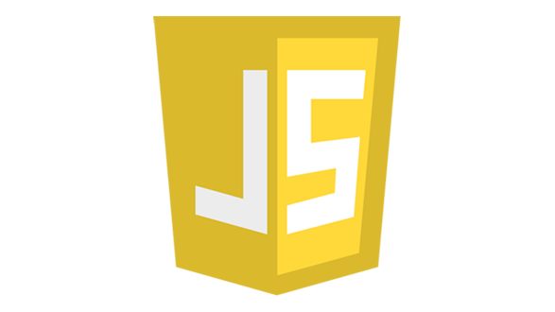
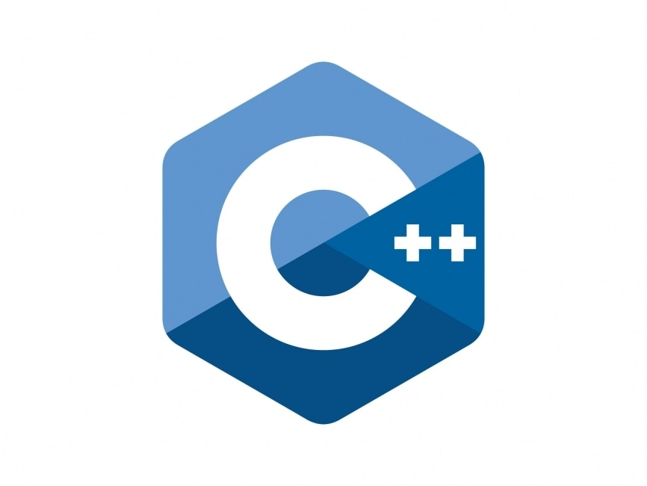

Python is pre-installed in most distros, let’s check if we have it or not:
python3 --version
If we don’t have it we can install it like this:
sudo apt install python3
How to run Python code ?
python3 filename.py
We can use nano, Vim or Vs code to write The code and then run it.

Slide 4
For JavaScript we have to
Install nodejs to run JS
outside of Browsers
$sudo apt install npm
For running JS code with
node we can use the command:
$node filename.js
Npm is nodeJs package manger => we use it to
download and install packages… npm installs
nodejs for us… so we can code outside of Browers

Slide 5
For installing c++ on ubuntu we have to at first isnatall build-essential:
$ sudo apt install build-essential
Installing gcc/g++ compiler:
$ sudo apt install g++
For cheeking if we have it installed:
$ g++ --version
We have to first Compile it using:
$ g++ samplefile.cpp –o samplefile
How to run the .cpp file:
./samplefile

Slide 6
Rust or rust-lang is a general-purpose programming language for system-level development projects. Rust is known for its speed, memory efficiency, seamless integration with other languages, and type safety.
Cheekking for rust on the system:
rustc -V
Instaling rust:
sudo apt install rustc
Running rust code:
$ rustc main.rs
$ ./main

Slide 7
For Java we need JDK => Java Development Kit
$ sudo apt install default-jdk
For compiling Java code we can use command:
$ javac filename.java
When we compile Java code this gives
us a filename.class file with the class
name we used in our program we have to
run this class to see the result:
$ java className

Slide 8
How to
Compile
And Run
Different
Languages on
Ubuntu
-Parsa Bordbar

